Slide 1
Keypoint Application: Panorama
Juan Carlos Niebles and Adrien Gaidon
Stanford Vision and Learning Lab
Slides by Anooshree Sengupta
Notes:
Application of upcoming content
homework is implementing a panorama from start to finish!

Slide 2
Outline
Quick review of keypoints and RANSAC
Panorama formulation
Matching corresponding keypoints
Stitching images together with affine transformation

Slide 3
Outline
Quick review of keypoints and RANSAC
Panorama formulation
Matching corresponding keypoints
Stitching images together with affine transformation

Slide 4
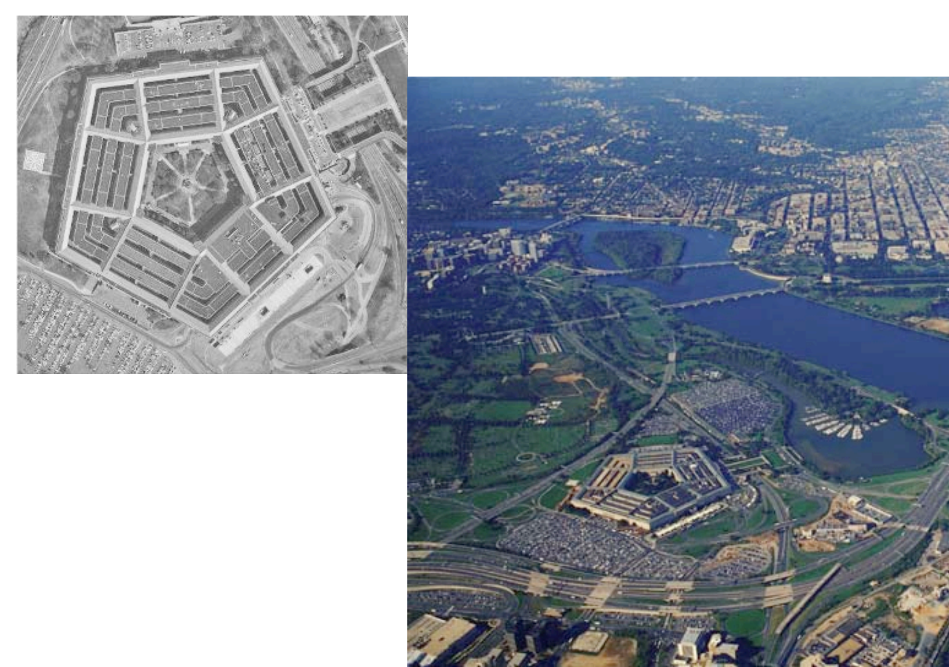
What are keypoints?
Reliable, unique points in images which can be used to find corresponding regions in different images of the same scene
Notes:
reliable points that you can use to identify an object in different regions

Slide 5
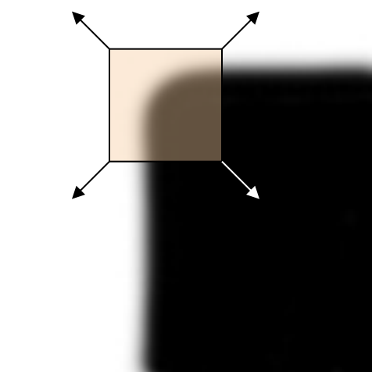
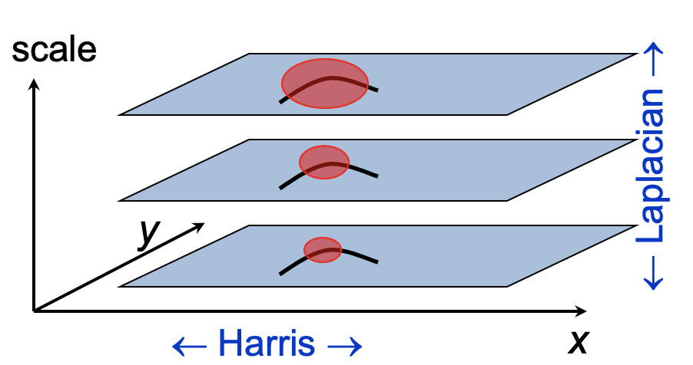
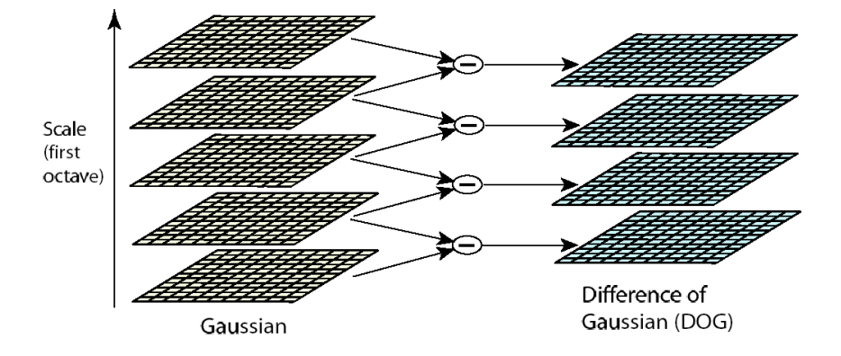
Finding keypoints
SCALE INVARIANT
Harris Corner Detector
Use gradient Eigenvalues to find corners at a certain scale
Harris-Laplacian
Find keypoints using Harris and scale using Laplacian filter
DoG
Use DoG filters to find keypoints across space and scale
Notes:
high gradient change in both directions: how we define a corner
Harris: scale matters
H-L: getting keypoints and scale of keypoints
DoG: what has large impact at a certain scale?

Slide 6
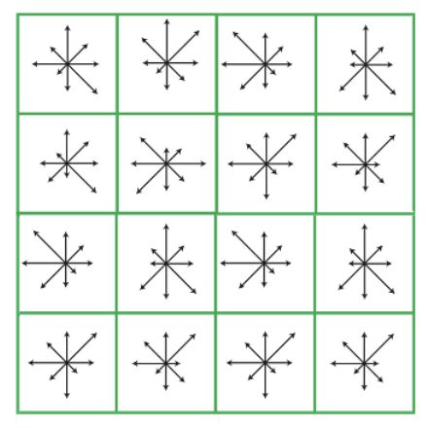
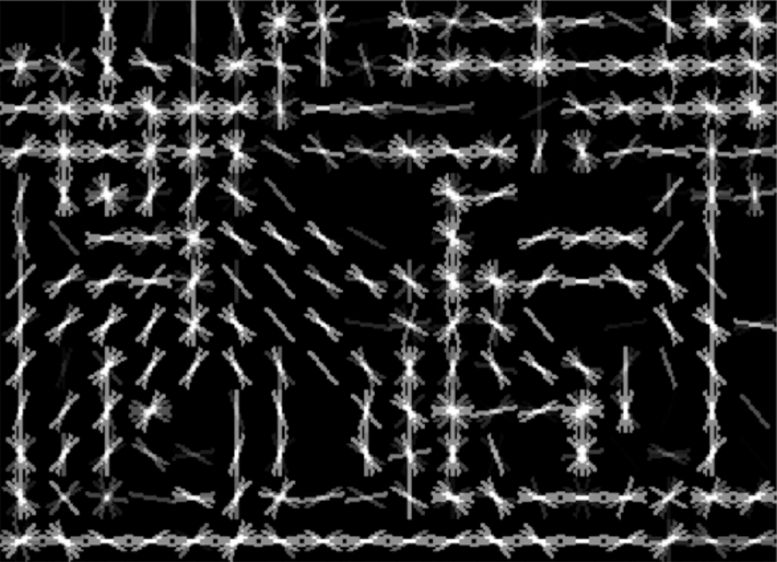
Describing keypoints
ROT. + SCALE INVARIANT
SIFT Descriptor
Keypoints as histogram of normalize gradient orientation
HoG
Region (or image) as histograms of local gradients
Notes:
How do we describe this information?
region can be described using the SIFT description
rotate the entire image and gradients wrt dominant gradient
Direction of gradient in surrounding pixels of keypoint
HOG is used to describe entire regions instead of just keypoints

Slide 7
RANSAC – algorithm for model fitting
Repeat n times:
Sample and form hypothesis
Find number of inliers
If max_inliers, save model
Recompute model on inliers
Notes:
RANSAC: fit a model to points
find two points to form a hypothesis
Find inliers to hypothesis
Save the model with the maximum number of inliers

Slide 8
RANSAC – algorithm for model fitting
Repeat n times:
Sample and form hypothesis
Find number of inliers
If max_inliers, save model
Recompute model on inliers

Slide 9
RANSAC – algorithm for model fitting
Repeat n times:
Sample and form hypothesis
Find number of inliers
If max_inliers, save model
Recompute model on inliers

Slide 10
RANSAC – algorithm for model fitting
Repeat n times:
Sample and form hypothesis
Find number of inliers
If max_inliers, save model
Recompute model on inliers
Notes:
Recompute the model using ALL of the inlier points
Ignores outliers, robust to noice

Slide 11
RANSAC – algorithm for model fitting
Repeat n times:
Sample and form hypothesis
Find number of inliers
If max_inliers, save model
Recompute model on inliers

Slide 12
Outline
Quick review of keypoints and RANSAC
Panorama formulation
Matching corresponding keypoints
Stitching images together with affine transformation

Slide 13
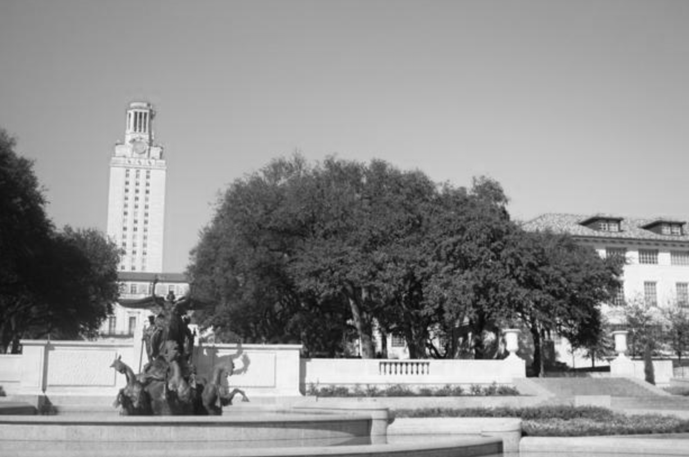
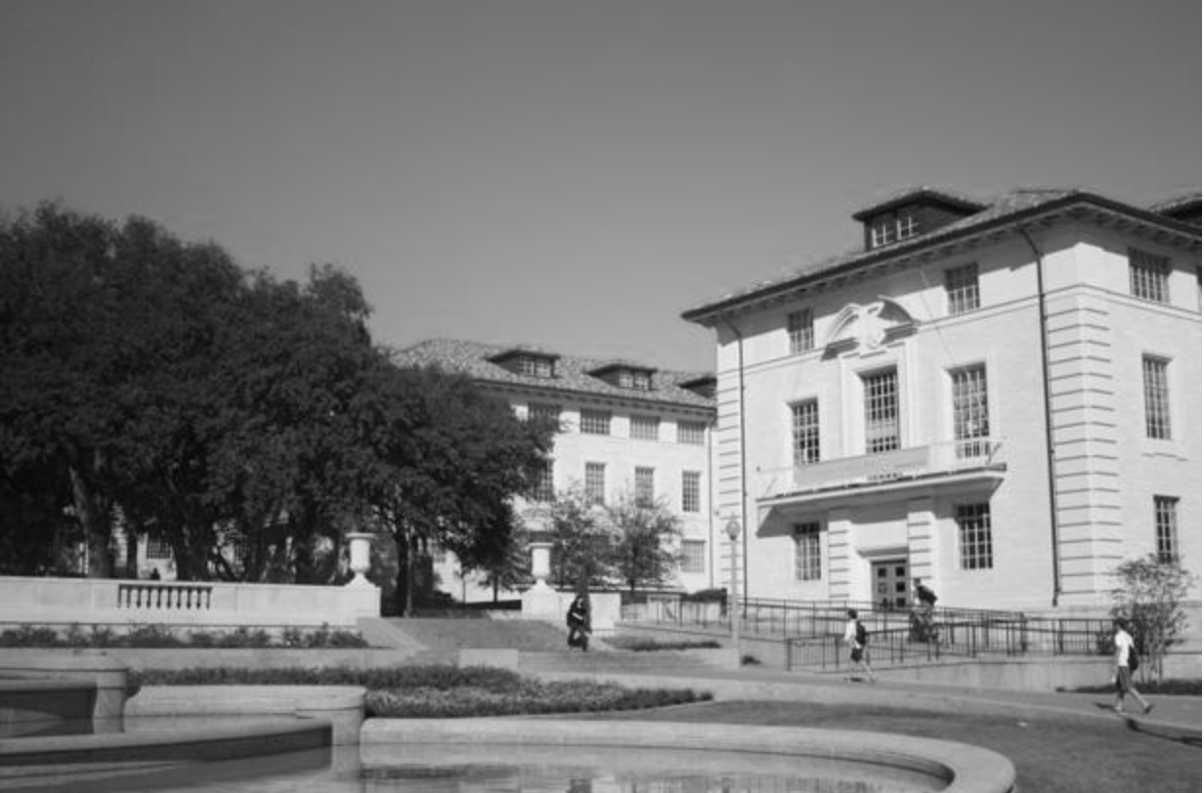
Panorama
Notes:
familiar concept & the focus of the next homework!

Slide 14
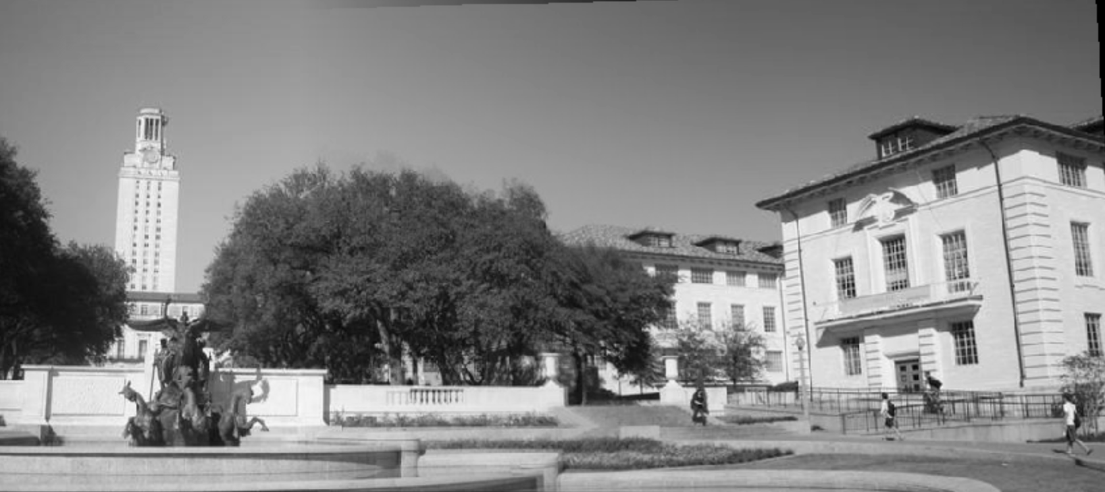
Panorama
Notes:
How do we stitch together two completely different images?
How can we seamlessly stitch them together?

Slide 15
Key insight: leverage corresponding keypoints
Notes:
shared keypoints throughout the image
Where are the keypoints the same, and how do we fit them together?

Slide 16
Problem 1: how to match keypoints?
Notes:
How do we find these lines?
How do we determine which keypoints correspond?

Slide 17
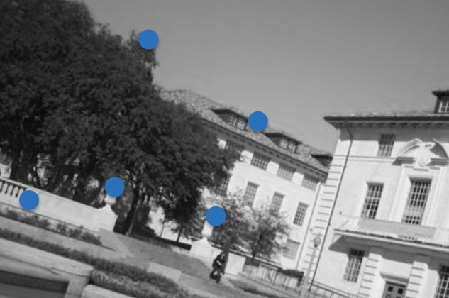
Problem 2: how to fit images?

Slide 18
Outline
Quick review of keypoints and RANSAC
Panorama formulation
Matching corresponding keypoints
Stitching images together with affine transformation

Slide 19
How to know if keypoints are “the same”?
Use keypoint descriptors!
Notes:
How do we know if keypoints match up?

Slide 20
Matching algorithm
For every keypoint in image_1:
Compute the euclidean distance from every keypoint in image_2
Sort keypoints by distance
If the first keypoint’s distance is significantly smaller than the second keypoint’s, it’s a match!
Return all eligible matches for keypoints in image_1
Try this with one for-loop!
Notes:
Something as simple as Euclidean distance!
lower distance, more similar keypoints!

Slide 21
Matching result

Slide 22
Outline
Quick review of keypoints and RANSAC
Panorama formulation
Matching corresponding keypoints
Stitching images together with affine transformation

Slide 23
Easy case: pictures taken from same angle

Slide 24
Hard case: pictures taken from diff angles

Slide 25
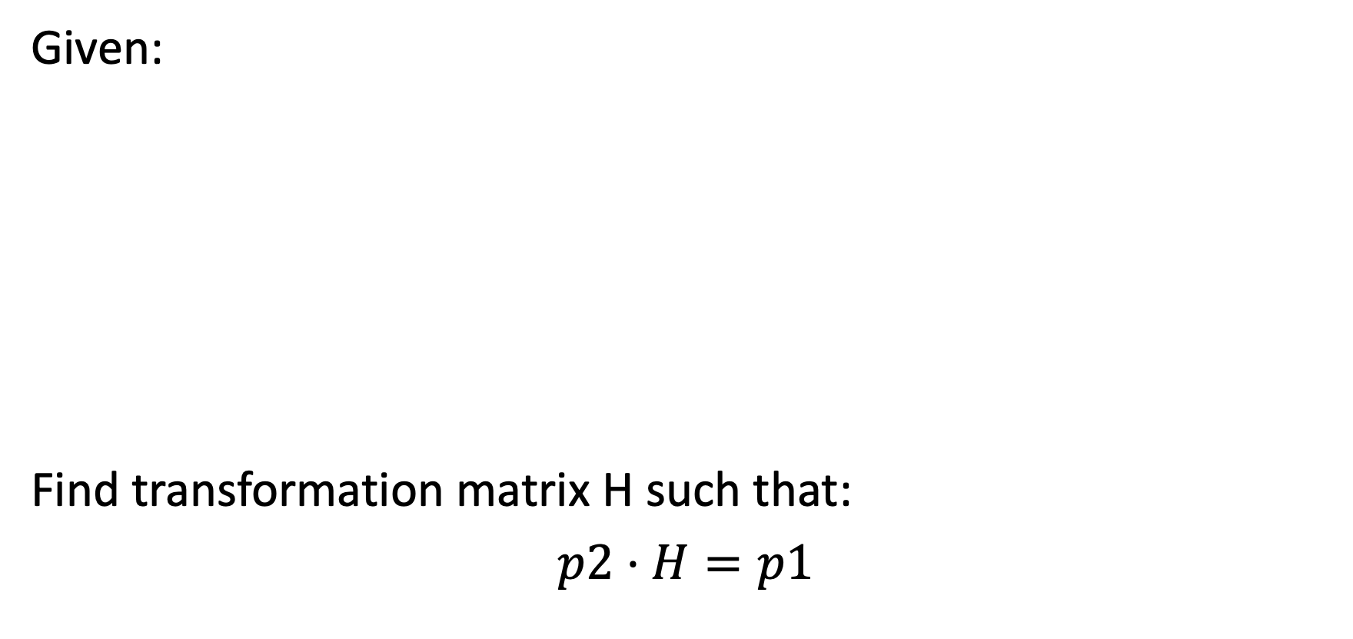
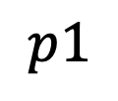
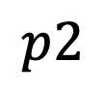
Find transformation between matches
 |  | 1
 |  | 1
 |  | 1
 |  | 1
 |  | 1
 |  | 1
 |  | 1
 |  | 1
Notes:
p1 are all of the keypoint matches: the rows correspond to points in image 1

Slide 26
What if we have noisy matches?
Refine transformation matrix with RANSAC!
Notes:
Refine with RANSAC

Slide 27
Pick subset

Slide 28
Fit affine matrix and find inliers
Notes:
After transformation, which keypoints are close to the keypoints in the other image?

Slide 29
Recompute matrix with all inliers and stitch!

Slide 30
Outline
Quick review of keypoints and RANSAC
Panorama formulation
Matching corresponding keypoints
Stitching images together with affine transformation

